Slide 1

Predicting NBA All Stars
SCMT 650 - Applied Predictive Analysis
Presented by,
Benjamin Kyle Clinton
Rahul Vincent Gerald
Varun Sagar Gajendragadkar

Slide 2
Agenda
Why We Chose NBA Data
Project Overview
Initial Dimension Reduction
Some Quick Visualizations
Models Created
Model Evaluations and Comparisons
Conclusion

Slide 3
Why this data topic?
Sports analytics is rapidly growing
Predicting All Stars has important applications
All Star Voting
Betting
Who got snubbed?
Models could be adapted for other projects
Data was clean and readily available
Sports are cool

Slide 4
Overview
Predicting NBA All Star team using player stats
Classification
Models: Logistic Regression, Decision Trees, Random Forests, and KNN
Information about the Data
Stats from 2000 to 2016
7,612 records
57 predictors initially
Merged different sets to get all the data into one set
Removed records with missing data

Slide 5
Initial Dimension Reduction
Needed to reduce number of predictors
Singularity errors
Highlighted predictors on correlation cut-off
Greater than 0.80 and less than -0.80
Reduced to 28 predictors
Fixed singularity issues

Slide 6
Some Interesting Data Visualizations

Slide 7
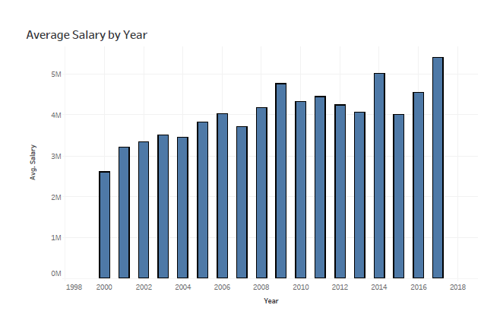

Slide 8
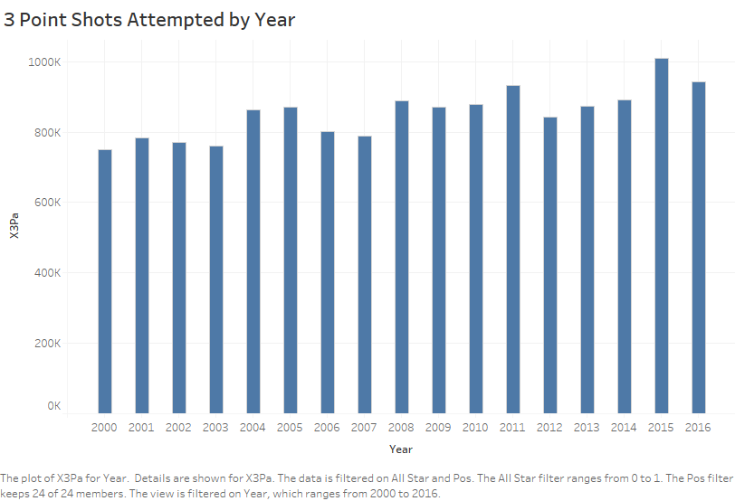
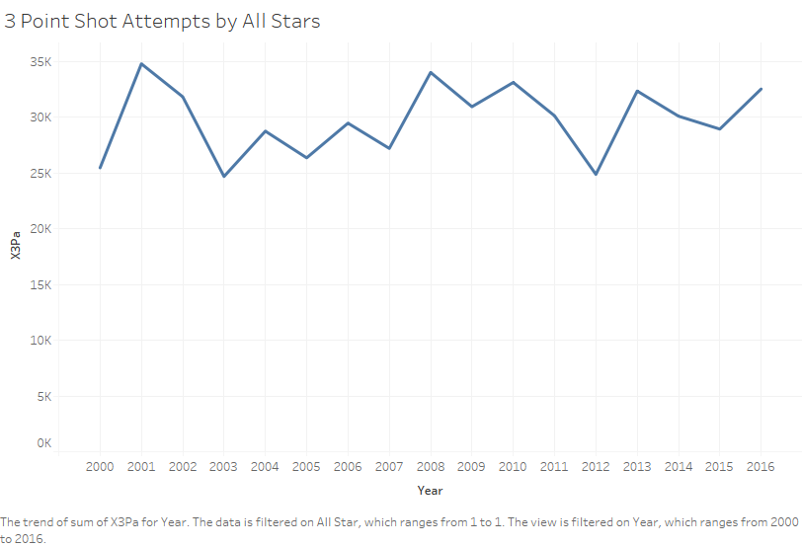
All Star 3PA not rising like total 3PA
3PA may not be a good predictor

Slide 9
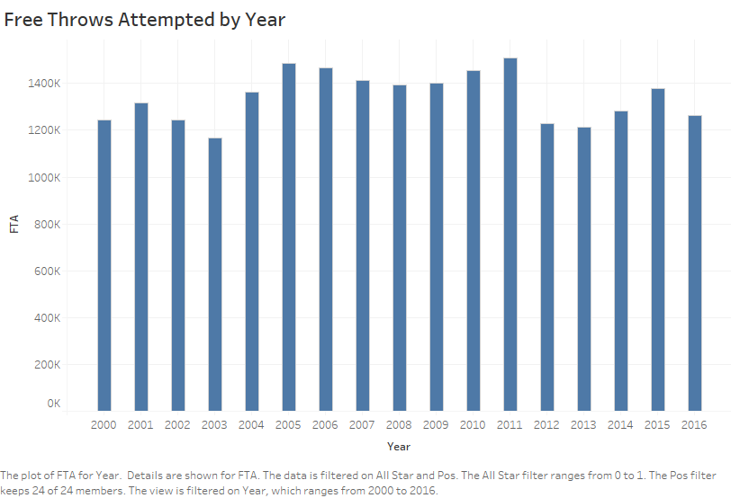
FTA seem to be trending down
The league is not as “soft” as people think

Slide 10
Logistic Regression

Slide 11
Logistic Regression
In this project for logistic regression, the data was trained and tested year wise
As in, year 2000 was training, 2001 was test, then 2001 training and 2002 was test and so on.
These models were built using all the predictors as well as only the seven best predictors.

Slide 12
Logistic Regression Using All Predictors
Train Data | Test Data | Accuracy
2000 | 2001 | 0.89
2001 | 2002 | 0.95
2002 | 2003 | 0.94
2003 | 2004 | 0.95
2004 | 2005 | 0.96
2005 | 2006 | 0.93
2006 | 2007 | 0.94
2007 | 2008 | 0.92
Train Data | Test Data | Accuracy
2008 | 2009 | 0.93
2009 | 2010 | 0.96
2010 | 2011 | 0.97
2011 | 2012 | 0.92
2012 | 2013 | 0.95
2013 | 2014 | 0.96
2014 | 2015 | 0.95
2015 | 2016 | 0.96
2016 | 2017 | 0.95

Slide 13
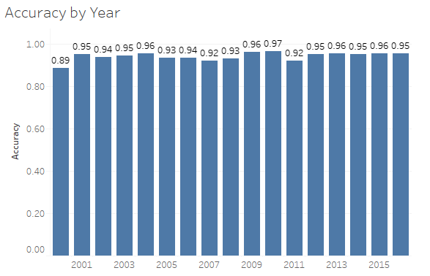

Slide 14
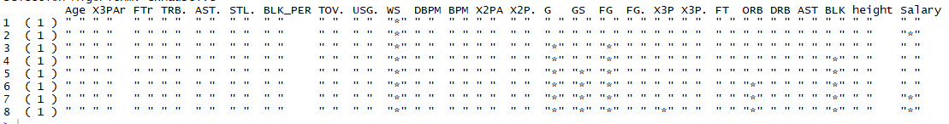
Logistic Regression Using Best Predictors
After using the regsubsets() - the best predictors for this model is found
regfit.full=regsubsets(AllStar~. ,data = train2000) summary(regfit.full)

Slide 15
Logistic Regression Using Best Predictors
The predictors used are as follows:
WS - win shares
G - games played
GS - games started
FG - field goals scored
ORB - offensive rebounds
BLK - blocks
Salary - the salary earned that season

Slide 16
Logistic Regression Using Best Predictors
Train Data | Test Data | Accuracy
2000 | 2001 | 0.94
2001 | 2002 | 0.96
2002 | 2003 | 0.95
2003 | 2004 | 0.96
2004 | 2005 | 0.97
2005 | 2006 | 0.96
2006 | 2007 | 0.95
2007 | 2008 | 0.97
Train Data | Test Data | Accuracy
2008 | 2009 | 0.94
2009 | 2010 | 0.97
2010 | 2011 | 0.96
2011 | 2012 | 0.95
2012 | 2013 | 0.95
2013 | 2014 | 0.95
2014 | 2015 | 0.97
2015 | 2016 | 0.96
2016 | 2017 | 0.97

Slide 17
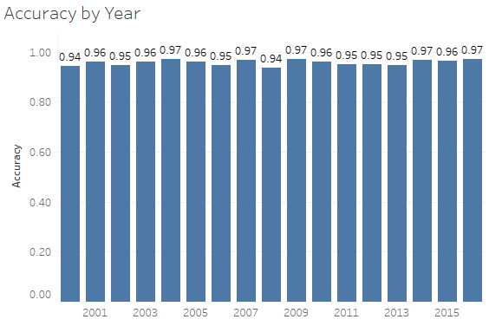

Slide 18
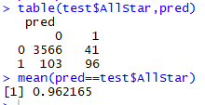
Logistic Regression - Whole Data Set
The regression function is run on the entire data set splitting it into an equal training and test data set. We observe the following:
Accuracy of Model = 0.962165
Confusion Matrix

Slide 19
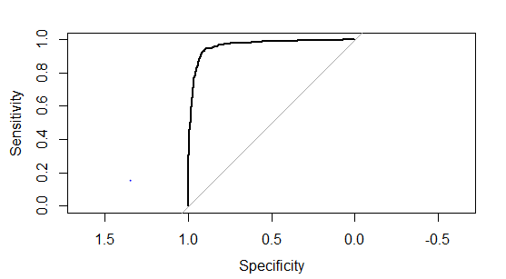
ROC Curve - AUC = 0.9632

Slide 20
KNN Classification

Slide 21
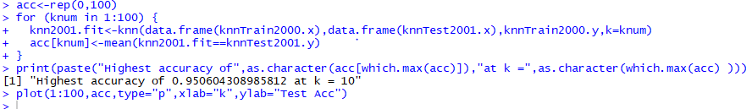
KNN Classification
KNN classification was used for the entire data set by sampling the data into two halves
The data predictors are preprocessed to the same scale
This classifier is run for different models from k values 1 to 100 as shown in the image below
The model with highest accuracy is k = 10 at 0.95

Slide 22
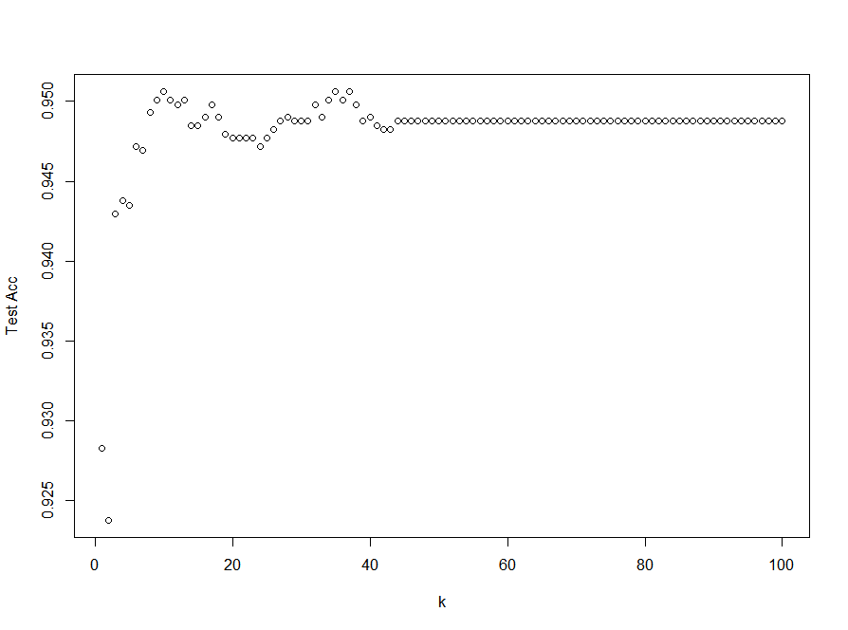
KNN Classification

Slide 23
Decision Trees
For decision trees, a method similar to Logistic Classification was chosen
Data was trained and tested year wise

Slide 24
Train Data | Test Data | Accuracy
2008 | 2009 | 0.9607
2009 | 2010 | 0.9587
2010 | 2011 | 0.9597
2011 | 2012 | 0.9597
2012 | 2013 | 0.9657
2013 | 2014 | 0.9607
2014 | 2015 | 0.9677
2015 | 2016 | 0.9578
2016 | 2017 | 0.9628
Train Data | Test Data | Accuracy
2000 | 2001 | 0.9621
2001 | 2002 | 0.9575
2002 | 2003 | 0.957
2003 | 2004 | 0.9656
2004 | 2005 | 0.9571
2005 | 2006 | 0.9661
2006 | 2007 | 0.9587
2007 | 2008 | 0.9611

Slide 25
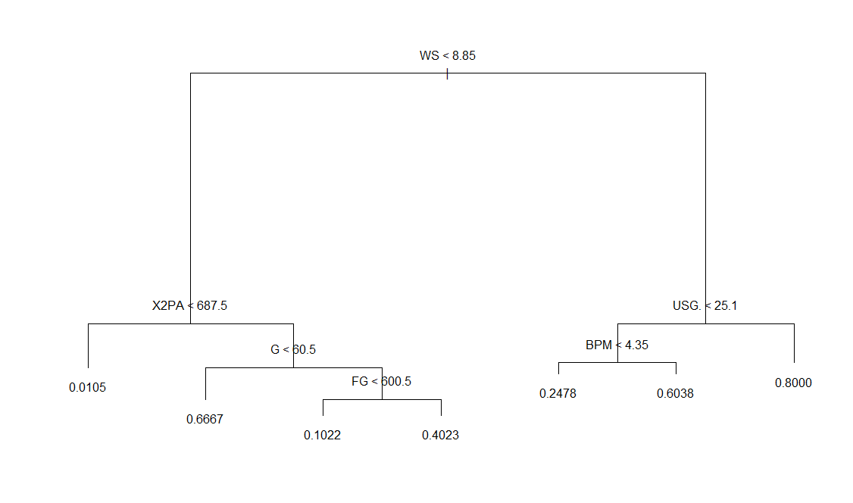

Slide 26
Important predictors
According to Decision trees, the following predictors are important:
WS: Win Shares - Estimation of number of wins a player gets for his team
X2PA: Number of 2 pointers attempted
USG: The ball usage rate of a player
G: Games played by a player
BPM: Box Plus Minus

Slide 27
Random Forest
For Random Forest, we divided the dataset into two parts
One part was used for training and the other for testing
The ntree value was set at 100

Slide 28

Confusion Matrix

Slide 29
Model Evaluation

Slide 30
Comparing Accuracy Rates
Logistic Regression | KNN Classification | Decision Trees | Random Forests
0.95 | 0.95 at K =10 | 0.9611 | 0.9626

Slide 31
Conclusion
Random Forests produced the best results
Only marginally better
Logistic regression output might be more interpretable
Future ideas:
Adapt models to other problems
Apply models to other sports
See how other methods compare
Make $$$ betting using the models

